Slide 1
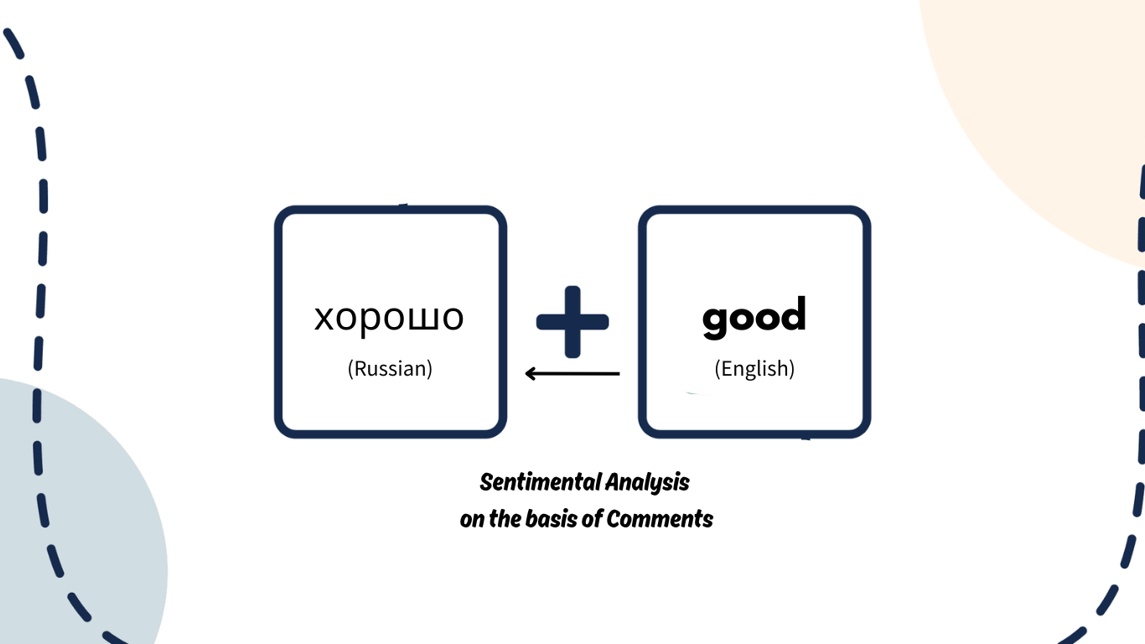
Sentiment Analysis
On basis of Russian Comments/Review of Customers

Slide 2

Outline
Introduction
Purpose of the project
Business Requirements
Steps to achieve A clean Report
Findings/Insights
Conclusion
What improvement can be done?
Difficulties Faced.

Slide 3
Introduction
Sentiment analysis of products sold to customers based on their comments and feedback helps businesses evaluate customer satisfaction. In this study, sentiment is classified into two categories: Positive and Negative, based on customer reviews which are in Russian Language.
Additionally, the dataset includes product ratings ranging from 1 to 5, providing further insights into customer perceptions. Products are categorized by item category, item ID, and brand ID to analyze sentiment trends across different segments.
This analysis enables businesses to identify strengths, address issues, and enhance product offerings to improve overall customer experience.

Slide 4

Purpose of the project
Analyze customer feedback to determine sentiment (Positive or Negative).
Utilize product ratings (1-5) to assess customer satisfaction levels.
Categorize products based on item category, item ID, and brand ID for deeper insights.
Identify trends in sentiment across different product segments.
Detect potential product issues and areas for improvement.
Help businesses make data-driven decisions to enhance customer experience.
Optimize marketing strategies and improve sales performance.

Slide 5
Business Requirements
How many Individual customers do they have?
How many brands are associated with the company for which it sells products?
What is the Tone of the Comment?
What is the translation of the Comment? (Russian to English)
What is the average rating of the Product?
When was the product purchased?
If there is a particular brand’s Products being sold then on the basis of customer’s Review what is the average rating of the overall brand?

Slide 6
Steps to achieve a Clean Report
Data Collection: Gather customer feedback, ratings, and product details (item category, item ID, brand ID).
Language Translation: Translate non-English comments (e.g., Russian) into English for uniform analysis.
Handling Missing Data: Identify and remove products with no reviews or comments.
Sentiment Classification: Categorize comments as Positive or Negative.
Rating Analysis: Map ratings (1-5) to sentiment for deeper insights.
Data Cleaning: Remove duplicates, irrelevant text, and inconsistencies.
Report Generation: Structure the cleaned data for meaningful insights and visual representation.

Slide 7
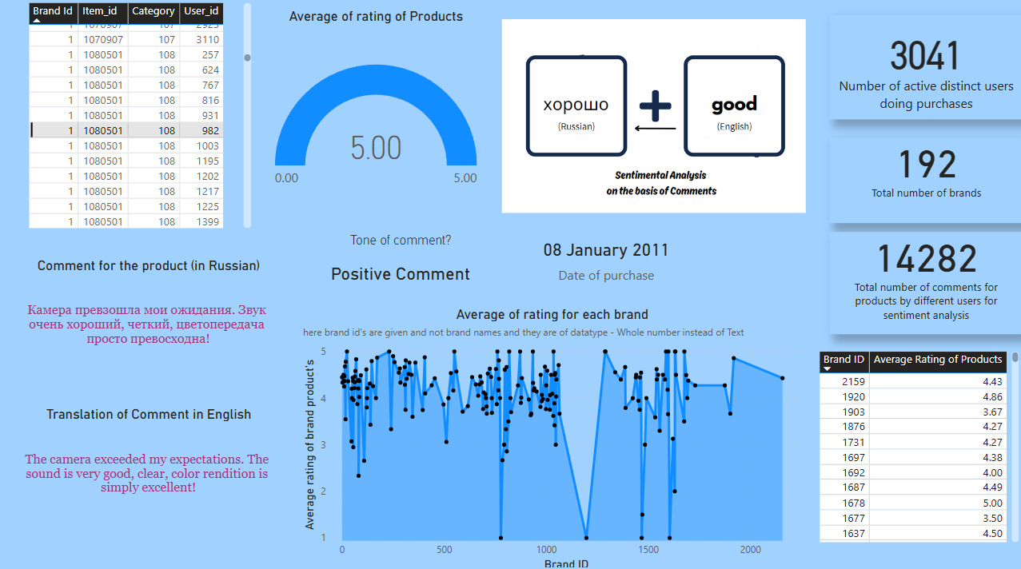
Findings/Insights

Slide 8
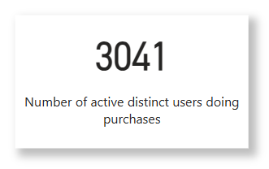
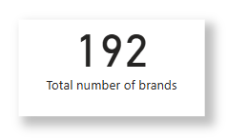
Company Insights
Out of multiple brands in the market. Company selected to sell and pick only 192 Brands in their niche, and they do have a good will for selling each of these Brand Products
The company has been in the business for a long time now and the comments are for the year between 2009-17.
During this duration the company had 3041 Active Distinct users doing multiple purchases

Slide 9
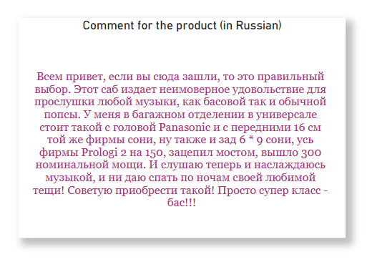
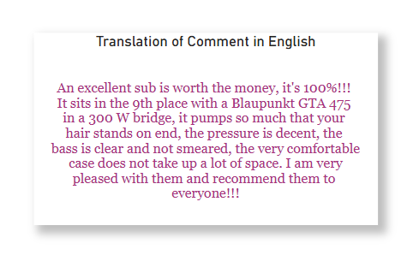
Understanding the comment
This above comment is for a product which is given by a customer in Russian language.
It can be difficult for someone like us who doesn't understand Russian. So, there is a way in which we translated each comment in English for better understanding.
This above is the translation of same comment that was in Russian Language. This can be easily understood by someone like us who understands English. By reading this comment you can tell that the comment is of
Positive tone.

Slide 10
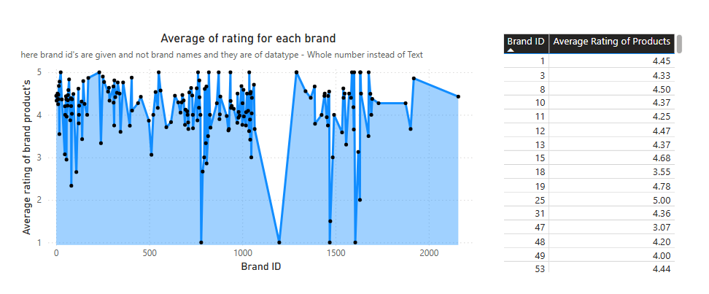
Rating Performance
The performance of the brand, or the product of any particular item or its category is identified only on the basis of feedback’s given by the customer; which can be only identified by the rating provided. Hence rating plays a very important role in analysis of sentiment of the customer for each product being sold to a customer.
This is the mentality a customer has if they want to purchase this product again. This can help increasing the sales.
The above graph shows average rating for each brand and the table shows average rating of products for each particular item for distinct brands.

Slide 11
Conclusion
Cleaning and preprocessing the raw data was essential, as it contained errors, missing values, and non-English comments, making it difficult to analyze. Translating Russian comments into a common language ensured better understanding and accurate sentiment classification. Handling missing values and refining the dataset allowed for a more structured and meaningful analysis.
A well-executed sentiment analysis of brands and items based on customer comments provides valuable insights into consumer preferences, helping businesses enhance their products and services. By identifying trends in positive and negative feedback, companies can improve product quality, optimize marketing strategies, and strengthen customer engagement. Additionally, understanding sentiment patterns helps in targeting the right audience, addressing pain points, and ultimately increasing sales, brand visibility, and customer loyalty.

Slide 12
What improvements can be done?
More Detailed Sentiment Analysis: Instead of just Positive or Negative, add more categories like Neutral or Very Positive for better insights.
Focus on Specific Product Features: Analyze which aspects (e.g., price, quality, durability) customers talk about the most.
Support More Languages: Expand translation beyond Russian to include other common languages.
Handle Missing Data Better: Instead of removing missing reviews, find patterns or predict possible feedback.
Compare Ratings with Comments: Check if ratings (1-5) match the sentiment in reviews to catch inconsistencies.
Filter Out Irrelevant Comments: Remove spam, promotional content, or unhelpful reviews automatically.
Compare with Competitors: Analyze similar brands to see how they perform in customer feedback.
Understand Customer Groups: Segment feedback based on customer type to personalize marketing.
Predict Future Trends: Use past data to forecast sales, customer satisfaction, and potential issues.

Slide 13


Issues Observed
Most primary difficulty that was faced was translation of the comments for understand the sentiment of each comment. As the comments were in Russian Language and converting it into English was a solution for better analysis. There were different ways to do it:
1) Using Python:
This could have been done using the python file where one can use the textblob function library.
2) Using Google Sheets for Translation using Function:
This was the method adopted in this project which was easier to execute. Just use the function (googletranslate) and drag the end of the cells and the translation will be ready.
( =GOOGLETRANSLATE(F2, "auto", "en") use this function in Google Sheets and drag and drop it and you’ll get all the translations)

Slide 14
Thankyou

